Slide 1

BLOOD BANK MANAGEMENT SYSTEM
Presented by :
Amit Kumar Sharma

Slide 2
INTRODUCTION
Blood is essential element of life, we need to donate blood to help peoples. Here presenting the Blood Bank Management System Project. This project idealised the blood bank database. The database of Blood Bank Management System Project will store the information of people who are willing to donate their blood.
The population of the world is multiplying with each coming year and so are the diseases and health issues. With an increase in the population there is an increase in the need of blood. The growing population of the world results in a lot of potential blood donors. But in spite of this not more than 10% of the total world population participates in blood donation.
Through this system it will be easier to find a donor for exact blood type and easy to build the connection between donor & the blood bank authorities.

Slide 3






OBJECTIVES
To check the availability of blood bags anytime.
Enable seekers to see available blood online at home without going far apart.
To provide easy way of commenting the system.
We aim to bridge the gap between blood donors and requestors.
Enable seekers to know the detail information about each blood in their home.
The main objective of the Project on Blood Bank Management System is to manage the details of Blood Bank, Blood Group, Donor, Blood Stock etc.

Slide 4
Feasibility Study
After doing the project Blood Bank Management System, study and analyzing all the existing or required functionalities of the system, the next task is to do the feasibility study for the project. All projects are feasible - given unlimited resources and infinite time.
Economical
Hardware and software are available in the market at an affordable cost so it is economically feasible.
Technical
Our site is developing using HTML, CSS & JavaScript and for backend PHP & MySQL and for hosting XAMPP is used which is supported by all of the systems and all the latest browsers so as all required soffware and hardware are available in the market so it is technically feasible.
Operational
It is easy to use and also in the time of emergency our website will save a lot of time to fetch a donor for the patience.

Slide 5

Software Requirement
Operating System : Window 7 or Above.
Languages : HTML, CSS, JS,PHP.
Database : MySQL
Server : XAMPP enabled with Apache and MySQL
Browser : Chrome.
Text Editor : Sublime Text / VS Code etc.

Slide 6

Hardware Requirement
Processor : Intel core i3
RAM : 4 GB or Above
Hard Drive : 500 GB or Above
64 bit Operating System

Slide 7
MODULES
Admin Admin can manage both donors and acceptors. Each member donor and acceptor is given a user id and password, which identifies him uniquely. Home Page The page where the system users will be redirected offer logging into the blood bank management system. This page displays the available volume of each blood group and also displays the system data summary. Donor Registration In this module, people who are interested in donating blood get registered in my website and give his overall details related to him, i.e. he fills in a registration form by giving the total details such as name, blood group, telephone numbers, email address, etc. He was also given two fields’ username and password to such that he was a registered donor and he can enter the login form with his username and password. Requests Page The page where all blood requests are listed and managed.

Slide 8
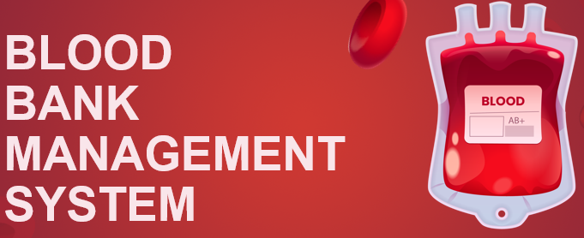
BLOOD GROUPS

Slide 9

ADVANTAGES
Patients can access the availability of blood units in blood banks by using this website.
Minimizes the efforts of the patient to find a donor in time.
Helps both donor and patient to keep record of there health.
As we have the contact numbers of the donors we can contact whenever necessary comes.

Slide 10

DISADVANTAGES
The website may have limited coverage, as it is created and maintained by a small team of students.
Need internet to operate.
The system cannot be receive or donate blood online.
The website is dependent on the availability of blood donors.
Here the blood is collecting only from the donors which are registered to our community, there is no tie up with any other hospitals.

Slide 11
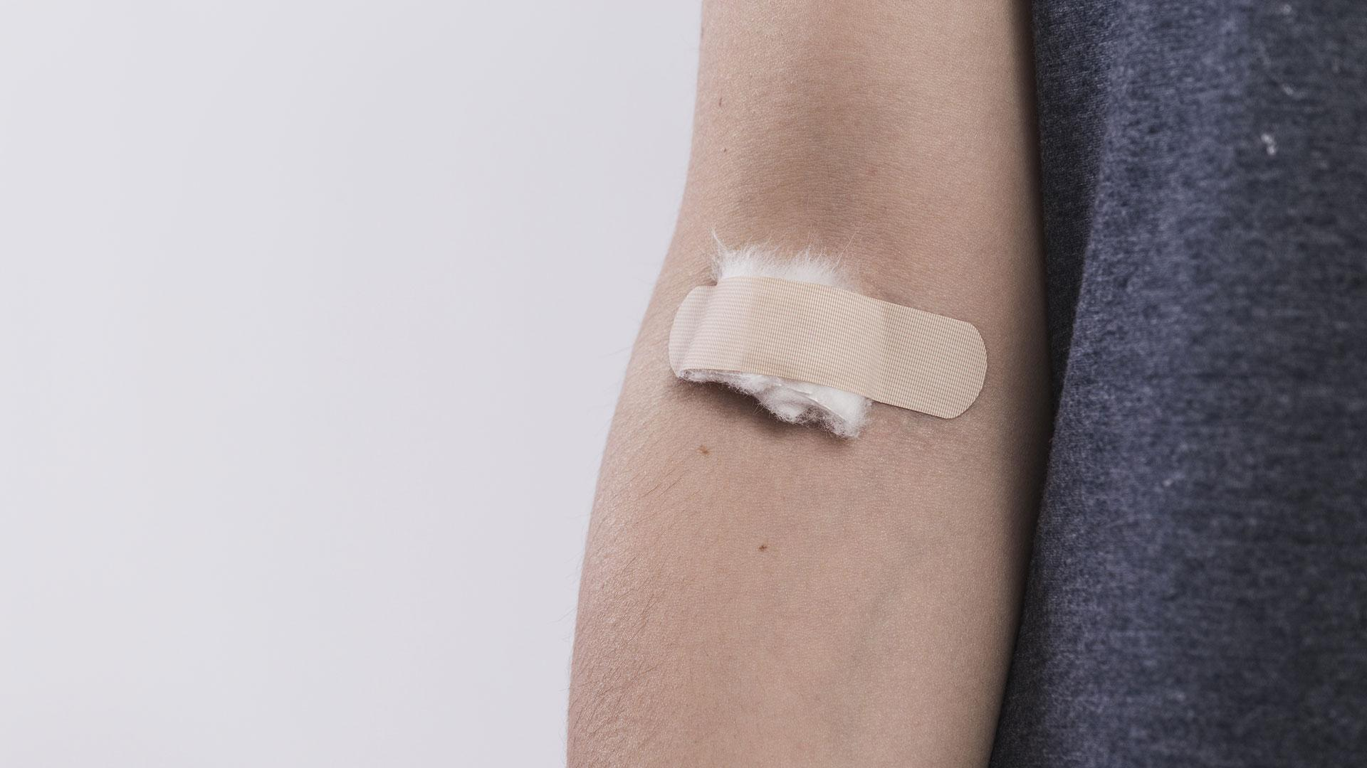

ACHIEVEMENTS OF THE PROJECT
Donors and Patients can create accounts on the system through
registration.
System Administrator can manage the users request.
To facilitate the search process for needy people and make it easier than before.
To reduce the data entry process.

Slide 12

Website Overview
Home

Slide 13
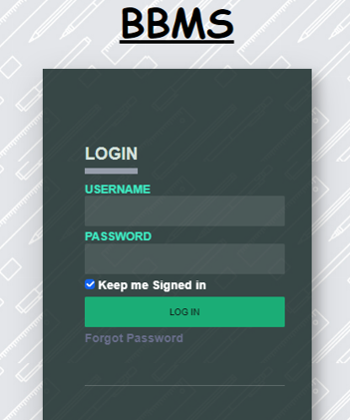
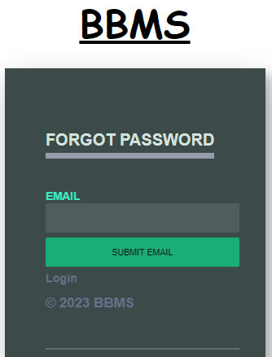
Login
Forgot Password

Slide 14
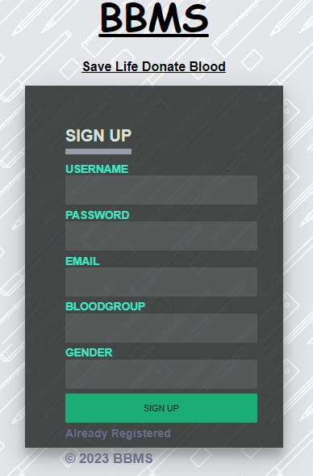
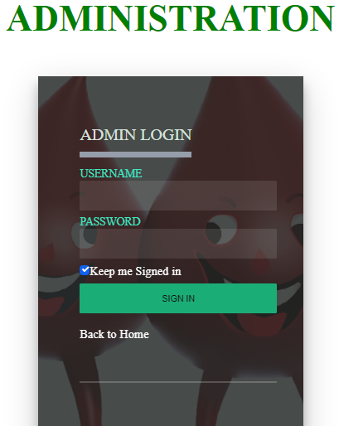
Sign Up
Admin Login

Slide 15
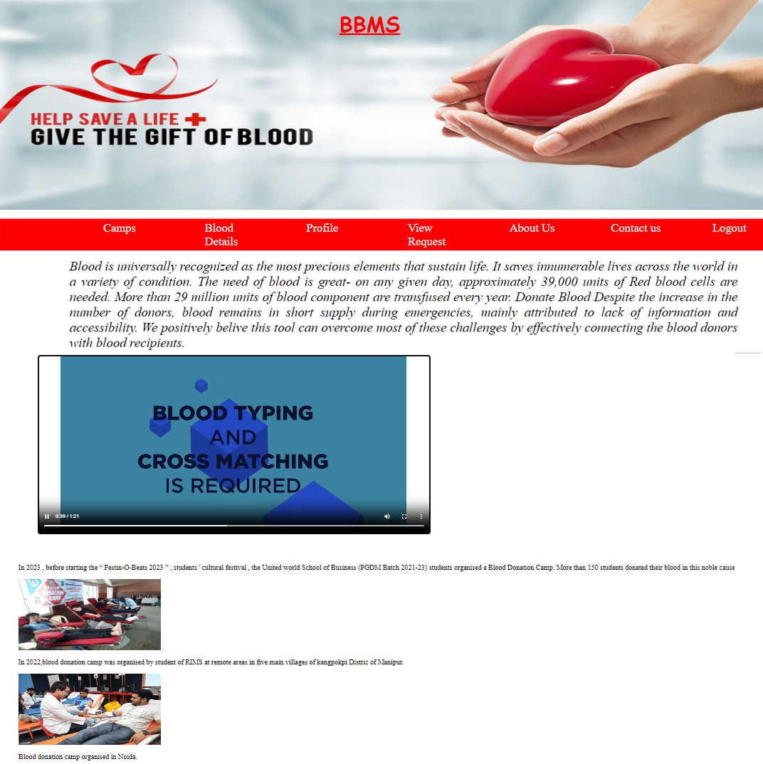
Donor/Recipient Home Page

Slide 16



Future Scope of the Project
The blood bank to store the details of the blood donated by person, like RBC, WBC, platelet count etc.
We will host the platform on online servers to make it accessible worldwide.
Handling information with related to blood donors, seekers and distribution information.
We can give more advance website for Blood Bank Management System including more facilities.

Slide 17
Conclusion
With the theoretical leaning of our syllabus it becomes very essential to take the advantage of any opportunity of gaining practical experience that comes along. The building blocks of this Major Project ”BLOOD BANK Management System” was one of these opportunities. It gave us the requisite practical knowledge to supplement the already taught theoretical concepts thus making us more competent as a computer engineer.

Slide 18


REFERENCES
Websites :
www.google.com
www.youtube.com
www.wikipedia.org
www.tutorialspoint.com
https://www.w3schools.com
https://en.wikipedia.org/wiki/Blood_type
https://en.wikipedia.org/wiki/Rh_blood_group_system
https://www.blood.co.uk/the-donation-process/further-information/tests-we-carry-out/
www.bloodbankservices.com
www.php.net/
http://www.bharatbloodbank.com

Slide 19


THANK YOU

